Slide 1
AZ Tours
The purpose of this site is to offer tours of Arizona for a fee..

Slide 2
Home
Scottsdale Tour
Grand Canyon
Sonoran Tour
Desert Tour
Form

Slide 3
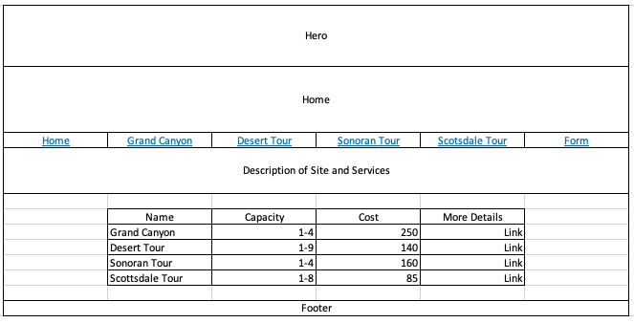

Slide 4
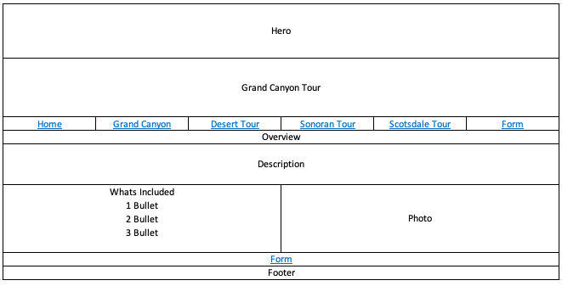

Slide 5
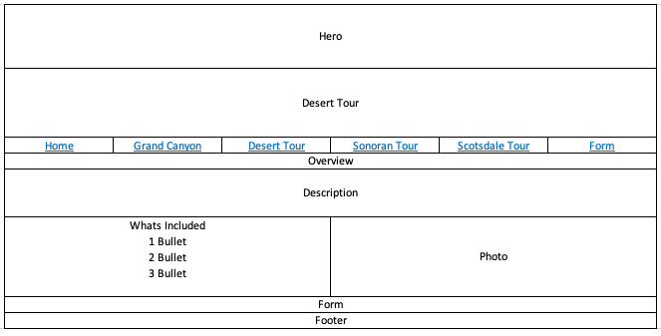

Slide 6
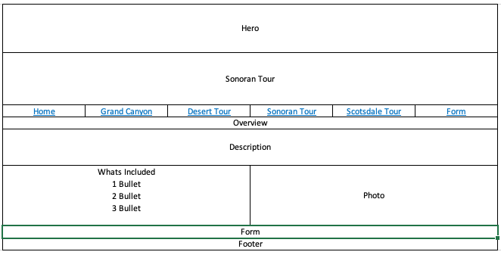

Slide 7
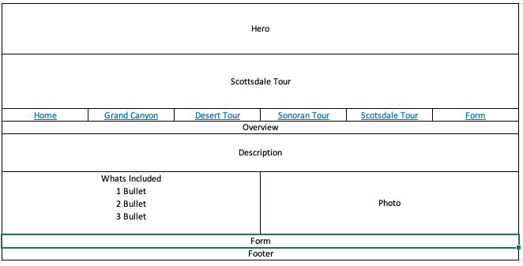

Slide 8
